Slide 1
Sasikala
Final Project
3/21/2024 Annual Review

Slide 2
PROJECT TITLE
VOICE ASSISTANT USING PYTHON
3/21/2024 Annual Review

Slide 3


AGENDA
The agenda for the discussion on “voice assistant using python” to empower users with a hands-free interface to access information, manage tasks, and control devices using just their voice. Whether it's checking the weather, setting reminders, or answering questions, this voice assistant project opens up a world of possibilities for seamless human-computer interaction. .
3/21/2024 Annual Review

Slide 4

PROBLEM STATEMENT
The objective of this project is to develop a comprehensive voice assistant using Python, capable of understanding natural language commands, executing tasks, and providing relevant information in real-time. The primary challenge lies in implementing robust speech recognition and natural language processing algorithms to accurately interpret user queries and extract actionable insights.
3/21/2024 Annual Review

Slide 5

PROJECT OVERVIEW
Overview:
The voice assistant project aims to create a sophisticated voice-enabled interface using Python, facilitating seamless interaction between users and technology through natural language commands. Leveraging Python's rich ecosystem of libraries and tools, the project will implement speech recognition to transcribe spoken words into text and natural language processing to understand user intents and extract relevant information. The assistant will be equipped with various features such as retrieving weather forecasts, fetching news updates, managing calendar events, and performing tasks like setting reminders or controlling smart home devices. By integrating with external APIs and services, the voice assistant will provide users with real-time access to relevant information and services. Error handling mechanisms will ensure graceful handling of unforeseen scenarios, enhancing the assistant's reliability and usability. Through intuitive user interfaces and seamless voice interaction, the project aims to empower users with a convenient and efficient means of accessing information and managing tasks, ultimately enhancing productivity and user experience in the digital era.
3/21/2024 Annual Review

Slide 6

WHO ARE THE END USERS?
General consumers
Professionals
Elderly or Visually Impaired Individuals
Students and Researchers
Tech Enthusiasts and Developers
3/21/2024 Annual Review

Slide 7

YOUR SOLUTION AND ITS VALUE PROPOSITION
Finally, the voice assistant solution is deployed for user accessibility, accompanied by comprehensive documentation and continuous feedback mechanisms to iteratively improve and refine the system based on user input and evolving requirements. Through these steps, the voice assistant project delivers a functional and efficient solution that enhances user productivity and convenience through voice-enabled technology.
Value Proposition: The value proposition of the voice assistant project lies in its ability to enhance user productivity, convenience, and accessibility through voice-enabled technology
3/21/2024 Annual Review

Slide 8

THE WOW IN YOUR SOLUTION
- Natural Language Understanding
Personalization
Task Automation
Accessibility
- Continuous Improvement
3/21/2024 Annual Review

Slide 9
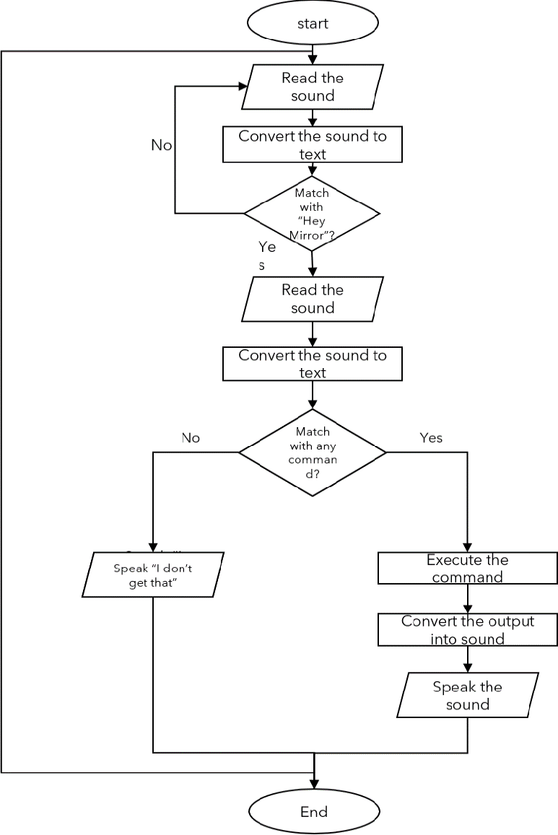
MODELLING
.
3/21/2024 Annual Review

Slide 10
RESULTS
The result of this voice assistant project is a sophisticated and user-friendly system that empowers users to interact with technology seamlessly using natural language commands. Through the integration of advanced speech recognition, natural language understanding, and task execution capabilities, the voice assistant effectively processes user input, executes tasks, and delivers responses in real-time. Overall, the result of this voice assistant project is a powerful and versatile system that enhances user productivity, convenience, and accessibility through voice-enabled technology.

